Slide 1
CENX 553 Selected topics
Prof. Sami Alwakeel
Factors Influencing Sensor Network
Design and Energy efficiency
Based on Chapter 3 of the book titled :Wireless Sensor Networks by Ian F. Akyildiz & Mehmet Can Vuran, A John Wiley and Sons, edition.

Slide 2
Factors Influencing Sensor Network Design
A. Hardware Constraints
B. Fault Tolerance (Reliability)
C. Scalability
D. Production Costs
E. Sensor Network Topology
F. Operating Environment (Applications)
G. Transmission Media
H. Power Consumption (Lifetime)

Slide 3
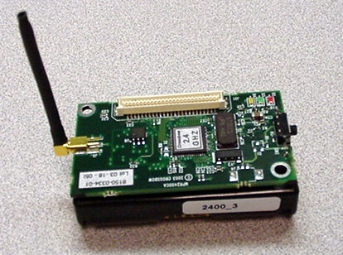
Sensor Node Hardware
Location Finding System
Mobilizer
SENSING UNIT
PROCESSING UNIT
Sensor ADC
Processor
Memory
Transceiver
Power Unit
Antenna

Slide 4
Fault Tolerance
(Reliability)
Sensor nodes may fail due to lack of power, physical damage or environmental interference
The failure of sensor nodes should not affect the overall operation of the sensor network
This is called
RELIABILITY or FAULT TOLERANCE,
i.e., ability to sustain sensor network functionality without any interruption

Slide 5
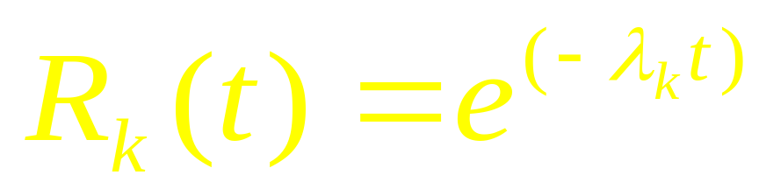
Fault Tolerance (Reliability)
Reliability R (Fault Tolerance) of a sensor node k is modeled:
i.e., by Poisson distribution, to capture the probability of not having a failure within the time interval (0,t) with l_{k} is the failure rate of the sensor node k and t is the time period.
G. Hoblos, M. Staroswiecki, and A. Aitouche, “Optimal Design of Fault Tolerant Sensor Networks,” IEEE Int. Conf. on Control Applications, pp. 467-472, Sept. 2000.

Slide 6
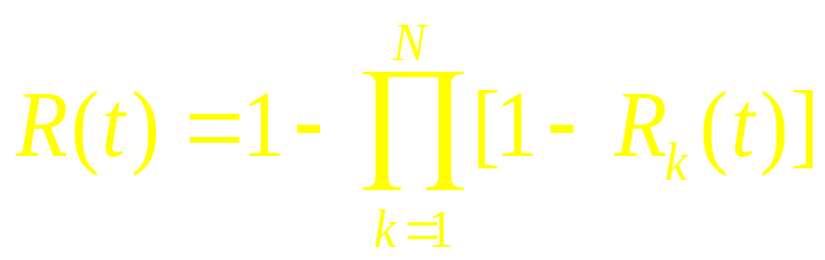
Fault Tolerance (Reliability)
Reliability (Fault Tolerance) of a broadcast range with N sensor nodes is calculated from

Slide 7
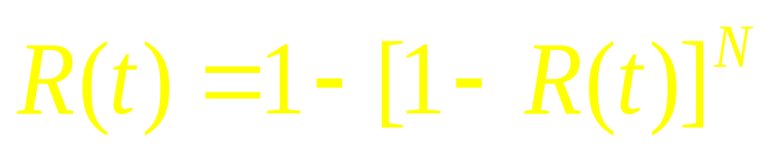
Fault Tolerance (Reliability)
EXAMPLE:
How many sensor nodes are needed within a broadcast radius (range) to have 99% fault tolerated network?
Assuming all sensors within the radio range have same reliability, previous equation becomes:
Drop t and substitute f = (1-R) →
0.99 = (1 – f^{N}) → N=2

Slide 8
Fault Tolerance (Reliability)
REMARK:
1. Protocols and algorithms may be designed to
address the level of fault tolerance required by
sensor networks.
2. If the environment has little interference, then
the requirements can be more relaxed.

Slide 9
Fault Tolerance (Reliability)
Examples:
  House to keep track of humidity and temperature levels → the sensors cannot be damaged easily or interfered by environment → low fault tolerance (reliability) requirement!!!!
  Battlefield for surveillance the sensed data are critical and sensors can be destroyed by enemies → high fault tolerance (reliability) requirement!!!
Bottom line: Fault Tolerance (Reliability)
depends heavily on applications!!!

Slide 10
Scalability
The number of sensor nodes may reach thousands in some applications
The density of sensor nodes can range from few to several hundreds in a region (cluster) which can be less than 10m in diameter

Slide 11


Scalability
Node Density: The number of expected nodes per unit area:
N is the number of scattered sensor nodes in region A
Node Degree: The number of expected nodes in the transmission range of a node
R is the radio transmission range
Basically: m(R) → is the number of sensor nodes within the transmission
radius R of each sensor node in region A.

Slide 12


Scalability
EXAMPLE:
Assume sensor nodes are evenly distributed in the sensor
field. Determine the node density and node degree if 200 sensor nodes are deployed in a 50x50 m² region where each sensor node has a broadcast radius of 5m.
Use the eq.

Slide 13
Scalability
Examples:
Machine Diagnosis Application:
less than 50 sensor nodes in a 5 m x 5 m region.
Vehicle Tracking Application:
Around 10 sensor nodes per cluster/region.
Home Application: tens depending on the size of the house.
Habitat Monitoring Application:
Range from 25 to 100 nodes/cluster
Personal Applications:
Ranges from tens to hundreds, e.g., clothing, eye glasses, shoes, watch, jewelry.

Slide 14
Production Costs
Cost of sensors must be low so that sensor networks can be justified!
PicoNode: less than $1
Bluetooth system: around $10,-
THE OBJECTIVE FOR SENSOR COSTS
must be lower than $1!!!!!!!
Currently → ranges from $25 to $180
(STILL VERY EXPENSIVE!!!!)

Slide 15
Sensor Network Topology
Sink
Internet, Satellite, UAV
Sink
Task
Manager

Slide 16
Sensor Network Topology
Topology maintenance and change:
  Pre-deployment and Deployment Phase
  Post Deployment Phase
  Re-Deployment of Additional Nodes

Slide 17
Sensor Network Topology
Pre-deployment and Deployment Phase
Dropped from aircraft → (Random deployment)
Well Planned, Fixed → (Regular deployment)
Mobile Sensor Nodes
  Adaptive, dynamic
  Can move to compensate for deployment shortcomings
  Can be passively moved around by some external force (wind, water)
  Can actively seek out “interesting” areas

Slide 18
Sensor Network Topology
Initial Deployment Schemes
Reduce installation cost
Eliminate the need for any pre-organization and pre-planning
Increase the flexibility of arrangement
Promote self-organization and fault-tolerance

Slide 19
Sensor Network Topology
POST-DEPLOYMENT PHASE
Topology changes may occur:
  Position
  Reachability (due to jamming, noise, moving obstacles, etc.)
  Available energy
  Malfunctioning

Slide 20
Operating Environment
* SEE ALL THE APPLICATIONS discussed before

Slide 21
TRANSMISSION MEDIA
Radio, Infrared, Optical, Acoustic, Magnetic Media
ISM (Industrial, Scientific and Medical) Bands (433 MHz ISM Band in Europe and 915 MHz as well as 2.4 GHz ISM Bands in North America)
REASONS: Free radio, huge spectrum allocation and global availability.

Slide 22
POWER CONSUMPTION
Sensor node has limited power source
Sensor node LIFETIME depends on BATTERY lifetime
Goal: Provide as much energy as possible at smallest cost/volume/weight/recharge
  Recharging may or may not be an option
Options
  Primary batteries – not rechargeable
  Secondary batteries – rechargeable, only makes sense in combination with some form of energy harvesting

Slide 23
Battery Examples
Energy per volume (Joule per cubic centimeter):
Primary batteries
Chemistry | Zinc-air | Lithium | Alkaline
Energy (J/cm³) | 3780 | 2880 | 1200
Secondary batteries
Chemistry | Lithium | NiMHd | NiCd
Energy (J/cm³) | 1080 | 860 | 650

Slide 24
Energy Scavenging (Harvesting)
Ambient Energy Sources (their power density)
  Solar (Outdoors) – 15 mW/cm² (direct sun)
  Solar (Indoors) – 0.006 mW/cm² (office desk)
  0.57 mW/cm² (<60 W desk lamp)
  Temperature Gradients – 80 μW/cm² at about 1V from a
  5Kelvin temp. difference
  Vibrations – 0.01 and 0.1 mW/cm³
  Acoustic Noises – 3*10^{{-6}} mW/cm² at 75dB
  - 9.6*10^{{-4}} mW/cm² at 100dB
  Nuclear Reaction – 80 mW/cm³

Slide 25
POWER CONSUMPTION
Sensors can be a DATA ORIGINATOR or a DATA ROUTER.
Power conservation and power management are important
→ POWER AWARE COMMUNICATION PROTOCOLS
must be developed.

Slide 26
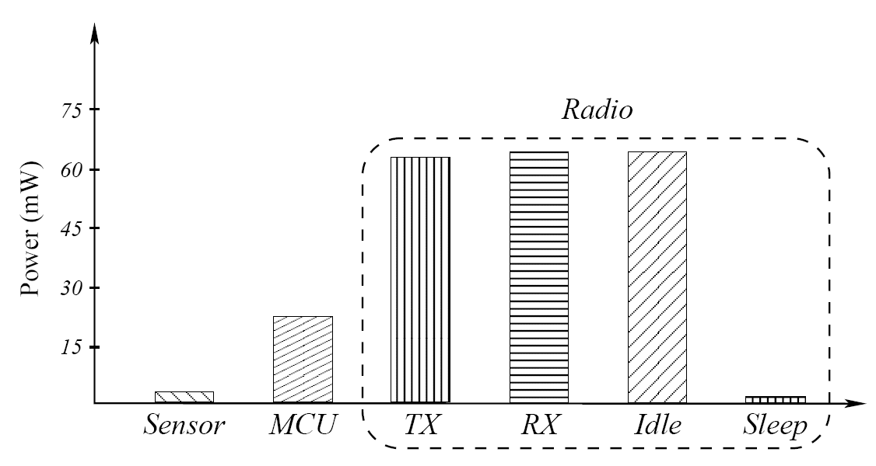
POWER CONSUMPTION

Slide 27
Power Consumption
Power consumption in a sensor network can be divided into three domains
  Sensing
  Data Processing (Computation)
  Communication

Slide 28
Power Consumption
Power consumption in a sensor network can be divided into three domains
  Sensing
  Data Processing (Computation)
  Communication

Slide 29
Power Consumption
Sensing
Depends on
    Application
    Nature of sensing: Sporadic or Constant
    Detection complexity
    Ambient noise levels
Rule of thumb (ADC power consumption)
F_{s} - sensing frequency, ENOB - effective number of bits

Slide 30
Power Consumption
Power consumption in a sensor network can be divided into three domains
  Sensing
  Data Processing (Computation)
  Communication

Slide 31
Power Consumption in
Data Processing (Computation)
(Wang/Chandrakarasan: Energy Efficient DSPs for Wireless Sensor
Networks. IEEE Signal Proc. Magazine, July 2002. also from Shih paper)
The power consumption in data processing (P_{p}) is
f clock frequency
C is the aver. capacitance switched per cycle (C ~ 0.67nF);
V_{dd} is the supply voltage
V_{T} is the thermal voltage (n~21.26; Io ~ 1.196 mA)

Slide 32
Power Consumption in
Data Processing (Computation)
The second term indicates the power loss due to leakage currents
In general, leakage energy accounts for about 10% of the total energy dissipation
In low duty cycles, leakage energy can become large (up to 50%)

Slide 33
Power Consumption in
Data Processing
This is much less than in communication.
EXAMPLE: (Assuming: Rayleigh Fading wireless channel; fourth power distance loss)
Energy cost of transmitting 1 KB over a distance of 100 m is approx. equal to executing 0.25 Million instructions by a 8 million instructions per second processor (MicaZ).
Local data processing is crucial in minimizing power consumption in a multi-hop network

Slide 34
Memory Power Consumption
Crucial part: FLASH memory
  Power for RAM almost negligible
FLASH writing/erasing is expensive
  Example: FLASH on Mica motes
  Reading: ¼ 1.1 nAh per byte
  Writing: ¼ 83.3 nAh per byte

Slide 35
Power Consumption
Power consumption in a sensor network can be divided into three domains
  Sensing
  Data Processing (Computation)
  Communication

Slide 36
Power Consumption for Communication
A sensor spends maximum energy in data communication (both for transmission and reception).
NOTE:
For short range communication with low radiation power (~0 dbm), transmission and reception power costs are approximately the same,
  e.g., modern low power short range transceivers consume between 15 and 300 mW of power when sending and receiving
Transceiver circuitry has both active and start-up power consumption

Slide 37
Power Consumption for
Communication
Power consumption for data communication (P_{c})
P_{c} = P₀ + P_{tx} + P_{rx}
TX RX
P_{te/re} is the power consumed in the transmitter/receiver
electronics (including the start-up power)
P₀ is the output transmit power

Slide 38
Power Consumption for
Communication
START-UP POWER/ START-UP TIME
A transceiver spends upon waking up from sleep mode, e.g., to ramp up phase locked loops or voltage controlled oscillators.
During start-up time, no transmission or reception of data is possible.
Sensors communicate in short data packets
Start-up power starts dominating as packet size is reduced
It is inefficient to turn the transceiver ON and OFF because a large amount of power is spent in turning the transceiver back ON each time.

Slide 39
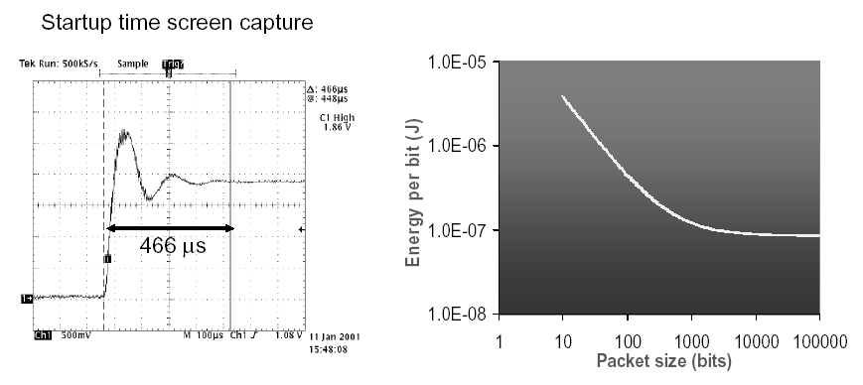
Wasted Energy
Fixed cost of communication: Startup Time
  High energy per bit for small packets (from Shih paper)
  Parameters: R=1 Mbps; T_{st} ~ 450 msec, P_{te}~81mW; P_{out} = 0 dBm

Slide 40
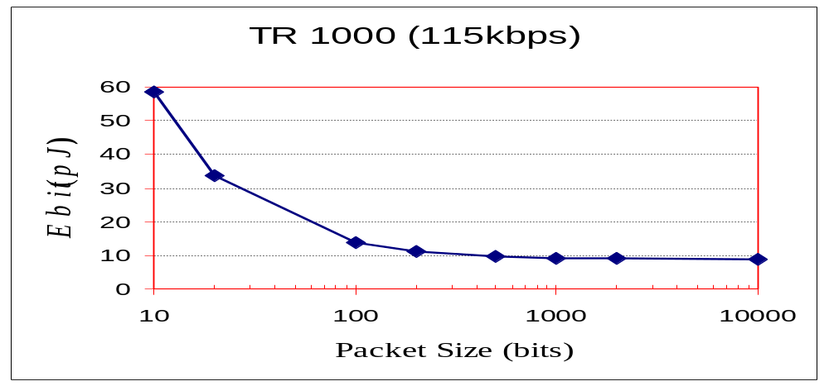
Energy vs Packet Size
Energy per Bit
(pJ)
As packet size is reduced the energy consumption is dominated by the startup time on the order of hundreds of microseconds during which large amounts of power is wasted.
NOTE: During start-up time NO DATA CAN BE SENT or RECEIVED by the
transceiver.

Slide 41
Start-Up and Switching
Startup energy consumption
E_{st} = P_{LO} x t_{st}
P_{LO}, power consumption of the circuitry (synthesizer and VCO); t_{st}, time required to start up all components
Energy is consumed when transceiver switches from transmit to receive mode
Switching energy consumption
E_{sw} = P_{LO} x t_{sw}

Slide 42
Start-Up Time and Sleep Mode
The effect of the transceiver startup time will greatly depend on the type of MAC protocol used.
To minimize power consumption, it is desirable to have the transceiver in a sleep mode as much as possible
Energy savings up to 99.99% (59.1mW → 3mW)
BUT…
Constantly turning on and off the transceiver also consumes energy to bring it to readiness for transmission or reception.

Slide 43
Receiving and Transmitting Energy Consumption
Receiving energy consumption
E_{rx} = (P_{LO} + P_{RX} ) t_{rx}
P_{RX}, power consumption of active components, e.g., decoder, t_{rx}, time it takes to receive a packet
Transmitting energy consumption
E_{tx} = (P_{LO} + P_{PA} ) t_{tx}
P_{PA}, power consumption of power amplifier
P_{PA} = 1/η P_{out}
η, power efficiency of power amplifier, P_{out}, desired RF output power level

Slide 44
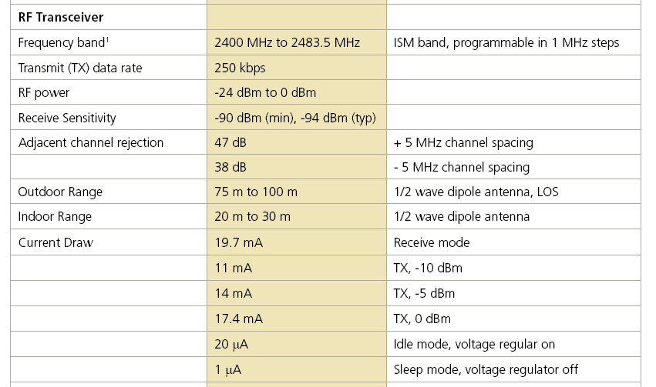
RF output power
http://memsic.com/support/documentation/wireless-sensor-networks/category/7-datasheets.html?download=148%3Amicaz

Slide 45
Power Amplifier Power Consumption
Receiving energy consumption
P_{PA} = 1/η ∙ γ_{PA} ∙ r ∙ d^{n}
γ_{PA}, amplifier constant (antenna gain, wavelength, thermal noise power spectral density, desired signal to noise ratio (SNR) at distance d),
r, data rate,
n, path loss exponent of the channel (n=2-4)
d, distance between nodes

Slide 46
Let’s put it together…
Energy consumption for communication
E_{c} = E_{st} + E_{rx} + E_{sw} + E_{tx}
= P_{LO} t_{st} + (P_{LO} + P_{RX})t_{rx} + P_{LO} t_{sw} + (P_{LO}+P_{PA})t_{tx}
Let t_{rx} = t_{tx} = l_{PKT}/r
E_{c} = P_{LO} (t_{st}+t_{sw})+(2P_{LO} + P_{RX})l_{PKT}/r + 1/η ∙ γ_{PA} ∙ l_{PKT} ∙ d^{n}
Distance-independent
Distance-dependent

Slide 47
A SIMPLE ENERGY MODEL
E_{Tx} (k,D)
E_{tx} (k,D) = E_{tx-elec} (k) + E_{tx-amp} (k,D)
E_{tx} (k,D) = E_{elec} * k + e_{amp} * k * D²
E_{Tx-elec} (k)
E_{Tx-amp} (k,D)
E_{Rx} (k) = E_{rx-elec} (k)
E_{Rx} (k) = E_{elec} * k
k bit packet
Transmit Electronics
Tx Amplifier
Operation | Energy Dissipated
Transmitter Electronics ( E_{Tx-elec}) Receiver Electronics ( E_{Rx-elec}) ( E_{Tx-elec} = E_{Rx-elec} = E_{elec} ) | 50 nJ/bit
Transmit Amplifier {e_{amp}} | 100 pJ/bit/m²
e_{amp}* k* D²
D
E_{elec} * k
E_{Rx} (k)
k bit packet
Receive Electronics
E_{elec} * k

Slide 48
Power Consumption
(A Simple Energy Model)
Assuming a sensor node is only operating in transmit and
receive modes with the following assumptions:
Energy to run circuitry:
E_{elec} = 50 nJ/bit
Energy for radio transmission:
e_{amp} = 100 pJ/bit/m²
Energy for sending k bits over distance D
E_{Tx} (k,D) = E_{elec} * k + e_{amp} * k * D²
Energy for receiving k bits:
E_{Rx} (k,D) = E_{elec} * k

Slide 49
Example using the Simple Energy Model
What is the energy consumption if 1 Mbit of information is transferred from the source to the sink where the source and sink are separated by 100 meters and the broadcast radius of each node is 5 meters?
Assume the neighbor nodes are overhearing each
other’s broadcast.

Slide 50
EXAMPLE
100 meters / 5 meters = 20 pairs of transmitting and
receiving nodes (one node transmits and one node receives)
E_{Tx} (k,D) = E_{elec} * k + e_{amp} * k * D²
E_{Tx} = 50 nJ/bit . 10⁶ + 100 pJ/bit/m^{2 .} 10^{6 .} 5² =
= 0.05J + 0.0025 J = 0.0525 J
E_{Rx} (k,D) = E_{elec} * k
E_{Rx} = 0.05 J
E_{pair} = E_{Tx} + E_{Rx} = 0.1025J
E_{T} = 20 . E_{pair} = 20. 0.1025J = 2.050 J

Slide 51
VERY DETAILED ENERGY MODEL
Simple Energy Consumption Model
A More Realistic ENERGY MODEL*
* S. Cui, et.al., “Energy-Constrained Modulation Optimization,” IEEE Trans. on Wireless Communications, September 2005.
Notes:
Second considers many circuit related parameters: power consumed at power amplifier, modulation effects, transition time & energy between ON-OFF states, frequency synthesizer power consumption, all the iddy biddy details.
For sure, the first model is too simplistic and should be enhanced.
But the question is how accurate a power model should be, how detailed it should be.
So, is the second approach an overkill??, or should it really be considered for all protocols. That is an open issue in modeling.

Slide 52
Details of the Realistic Model
L – packet length
B – channel bandwidth
N_{f} – receiver noise figure
σ² – power spectrum energy
P_{b} – probability of bit error
G_{d} – power gain factor
P_{c} – circuit power consumption
P_{syn} – frequency synthesizer power
consumption
T_{tr} – frequency synthesizer settling time (duration of transient mode)
T_{on} – transceiver on time
M – Modulation parameter

Slide 53
ANOTHER EXAMPLE
Enery Consumption: Important Variables:
P_{re} → 4.5 mA (energy consumption at receiver)
P_{te} → 12.0 mA (energy consumption at transmitter)
P_{cl} → 12.0 mA → (basic consumption without radio)
P_{sl} → 8mA (0.008 mA) → (energy needed to sleep)

Slide 54
EXAMPLE
Capacity (Watt) = Current (Ampere) * Voltage (Volt)
Rough estimation for energy consumption and sensor lifetime:
Let us assume that each sensor should wake up once a
second, measure a value and transmit it over the network.
  a) Calculations needed: 5K instructions (for measurement and
  preparation for sending)
  b) Time to send information: 50 bytes for sensor data,
  (another 250 byte for forwarding external data)
  c) Energy needed to sleep for the rest of the time (sleep
  mode)

Slide 55
EXAMPLE
Time for Calculations and Energy Consumption:
MSP430 running at 8 MHz clock rate → one cycle
takes 1/(8*10⁶) seconds
1 instruction needs an average of 3 cycles → 3/
(8* 10⁶) sec, 5K instructions, 15/(8*10³) sec
15/(8*10³) * 12mA = 180/8000 = 0.0225 mAs

Slide 56
EXAMPLE
Time for Sending Data and Energy Consumption:
Radio sends with 19.200 baud (approx. 19.200 bits/sec)
→ 1 bit takes 1/19200 seconds
We have to send 50 bytes (own measurement)
and we have to forward 250 bytes (external
data): 250+50=300 which takes
300*8/19200s*24mA (energy basic + sending) = 3mAs

Slide 57
EXAMPLE
Energy consumed while sleeping:
  Time for calculation 15/8000 + time for transmission
  300*8/19200 ~ 0.127 sec
  Time for sleep mode = 1 sec – 0.127 = 0.873 s
  Energy consumed while sleeping
  0.008mA * 0.873 s = 0.0007 mAs

Slide 58
EXAMPLE
Total Amount of energy and resulting lifetime:
  The ESB needs to be supplied with 4.5 V so we need
  3 * 1.5V AA batteries.
  3*(0.0225 + 3 + 0.007) ~ 3 * 3.03 mWs
  Energy of 3AA battery ~ 3 * 2300 mAh = 3*2300*60*60 mWs
  Total lifetime → 3*2300*60*60/3*3.03 ~ 32 days.

Slide 59
EXAMPLE
NOTES:
Battery suffers from large current (losing about 10% energy/year)
Small network (forwarding takes only 250 bytes)
Most important:
Only sending was taken into account, not receiving
If we listen into the channel rather than sleeping 0.007 mA has to be replaced by (12+4.5)mA
which results in a lifetime of ~ 5 days.

Slide 60
Power Consumption for Communication (Detailed Formula)
where
P_{te} is power consumed by transmitter
P_{re} is power consumed by receiver
P_{O} is output power of transmitter
T_{on} is transmitter “on” time
R_{on} is receiver “on” time
T_{st} is start-up time for transmitter
R_{st} is start-up time for receiver
N_{T} is the number of times transmitter
is switched “on” per unit of time
N_{R} is the number of times receiver
is switched “on” per unit of time
E. Shih et al.,”Physical Layer Driven Protocols and Algorithm Design for Energy-Efficient Wireless Sensor Networks”, ACM MobiCom, Rome, July 2001.

Slide 61
Power Consumption for
Communication
T_{on} = L / R
  where L is the packet size in bits and R is the data rate.
N_{T} and N_{R} depend on MAC and applications!!!

Slide 62
What can we do to Reduce Energy Consumption
→ Multiple Power Consumption Modes
Way out: Do not run sensor node at full operation all the time
  If nothing to do, switch to power safe mode
  Question: When to throttle down? How to wake up again?
Typical modes
  Controller: Active, idle, sleep
  Radio mode: Turn on/off
  transmitter/receiver, both

Slide 63
Multiple Power Consumption Modes
Multiple modes possible →
“Deeper” sleep modes
  Strongly depends on hardware
  TI MSP 430, e.g.: four different sleep modes
  Atmel ATMega: six different modes

Slide 64
Multiple Power Consumption Modes
Microcontroller
  TI MSP 430
    Fully operation 1.2 mW
    Deepest sleep mode 0.3 μW – only woken up by external interrupts (not even timer is running any more)
  Atmel ATMega
    Operational mode: 15 mW active, 6 mW idle
    Sleep mode: 75 μW

Slide 65
Switching between Modes
Simplest idea: Greedily switch to lower mode whenever possible
Problem: Time and power consumption required to reach higher modes not negligible
  Introduces overhead
  Switching only pays off if E_{saved} > E_{overhead}

Slide 66
Switching between Modes
Example: Event-triggered wake up from sleep mode
Scheduling problem with uncertainty
E_{saved}
E_{overhead}
P_{active}
P_{sleep}
t₁
t_{event}
time
t_{down}
t_{up}

Slide 67
Alternative: Dynamic Voltage Scaling
Switching modes complicated by uncertainty on how long a sleep time is available
Alternative: Low supply voltage & clock
  Dynamic Voltage Scaling (DVS)
  A controller running at a lower speed, i.e., lower clock rates, consumes less power
  Reason: Supply voltage can be reduced at lower clock rates while still guaranteeing correct operation

Slide 68
Alternative: Dynamic Voltage Scaling
Reducing the voltage is a very efficient way to reduce power consumption.
Actual power consumption P depends quadratically on the supply voltage V_{DD}, thus,
P ~ V_{DD}²
Reduce supply voltage to decrease energy consumption !

Slide 69
Alternative: Dynamic Voltage Scaling
Gate delay also depends on supply voltage
  K and a are processor dependent (a ~ 2)
Gate switch period T₀=1/f
For efficient operation
T_{g} <= T_{o}

Slide 70
Alternative: Dynamic Voltage Scaling
f is the switching frequency
where a, K, c and V_{th} are processor dependent variables (e.g., K=239.28 Mhz/V, a=2, and c=0.5)
REMARK: For a given processor the maximum performance f of the processor is determined by the power supply voltage V_{dd} and vice versa.
NOTE: For minimal energy dissipation, a processor should operate at the lowest voltage for a given clock frequency

Slide 71
Computation vs. Communication Energy cost
Tradeoff?
  Directly comparing computation/communication energy cost not possible
  But: put them into perspective!
  Energy ratio of “sending one bit” vs. “computing one instruction”: Anything between 220 and 2900 in the literature
  To communicate (send & receive) one kilobyte = computing three million instructions!

Slide 72
Computation vs. Communication Energy Cost
BOTTOMLINE
  Try to compute instead of communicate whenever possible
Key technique in WSN – in-network processing!
Exploit compression schemes, intelligent coding schemes, aggregation, filtering, …

Slide 73
BOTTOMLINE:
Many Ways to Optimize Power Consumption
Power aware computing
  Ultra-low power microcontrollers
  Dynamic power management HW
    Dynamic voltage scaling (e.g Intel’s PXA, Transmeta’s Crusoe)
    Components that switch off after some idle time
Energy aware software
  Power aware OS: dim displays, sleep on idle times, power aware scheduling
Power management of radios
  Sometimes listen overhead larger than transmit overhead

Slide 74
BOTTOMLINE:
Many Ways to Optimize Power Consumption
Energy aware packet forwarding
  Radio automatically forwards packets at a lower power level, while the rest of the node is asleep
Energy aware wireless communication
  Exploit performance energy tradeoffs of the communication subsystem, better neighbor coordination, choice of modulation schemes

Slide 75



COMPARISON
Mote
Bluetooth
Energy per bit
Idle current
Startup time
IEEE 802.11
Technology | Data Rate | Tx Current | Energy per bit | Idle Current | Startup time
Mote | 76.8 Kbps | 10 mA | 430 nJ/bit | 7 mA | Low
Bluetooth | 1 Mbps | 45 mA | 149 nJ/bit | 22 mA | Medium
802.11 | 11 Mbps | 300 mA | 90 nJ/bit | 160 mA | High

